Slide 1
Amrita Vishwa Vidyapeetham, Amaravati Campus
Subject Name with Code
Simulate a Mobile Robot in a Warehouse Using Gazebo
Name of the Student | Roll No.
S Akhil | AV.EN.U4CSE22140
V Hemanth Kumar | AV.EN.U4CSE22147
T Uday Kiran | AV.EN.U4CSE22245

Slide 2
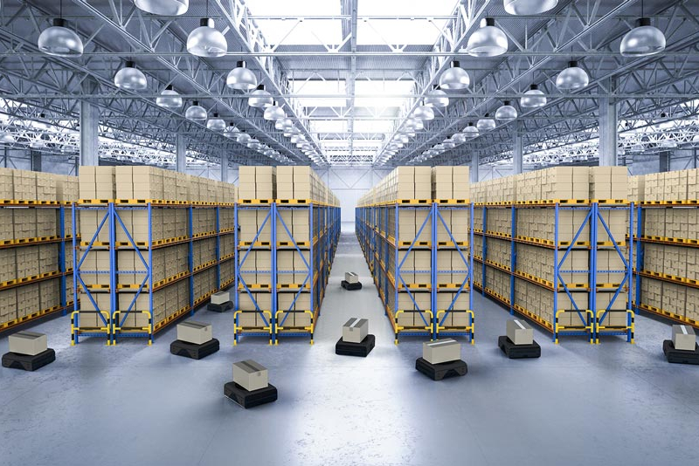
Introduction
This project focuses on developing an autonomous warehouse navigation system using ROS (Robot Operating System) and Gazebo for simulation. In modern warehouses, autonomous mobile robots (AMRs) play a crucial role in optimizing inventory management and transportation by navigating efficiently through aisles while avoiding obstacles.
Using Dijkstra’s algorithm, the shortest path is computed, enabling the robot to transport goods efficiently. The robot follows the computed path while dynamically adjusting to environmental changes, ensuring smooth and collision-free navigation.

Slide 3
Problem Statement, Objectives and Programming Language
Problem Statement
Develop an autonomous robot navigation system for warehouse environments using ROS and LiDAR. The goal is to enable efficient, obstacle-free movement by computing the shortest path using Dijkstra’s algorithm.
Objectives
Implement autonomous warehouse navigation.
Use LiDAR to create an occupancy grid map.
Apply Dijkstra’s algorithm for path planning.
Control robot movement using ROS and velocity commands.
Programming Languages Used
MATLAB: Used for interfacing with Gazebo and implementing algorithms for robot control
Gazebo: A 3D simulation tool for testing robotics applications in a virtual environment

Slide 4
Methodology
Sensor Data Processing
LiDAR captures real-time data, filters invalid readings, and converts coordinates.
Mapping & Obstacle Avoidance
Creates a 6x6m occupancy grid, marking and inflating obstacles for safety.
Path Planning (Dijkstra’s Algorithm)
Converts the occupancy grid into a cost matrix and finds the shortest path.
Robot Motion Control
Robot follows the planned path using velocity commands for smooth movement.
How This Helps:
Efficient Navigation – Optimizes travel time.
Obstacle Avoidance – Ensures collision-free movement.
Warehouse Automation – Reduces human intervention.

Slide 5
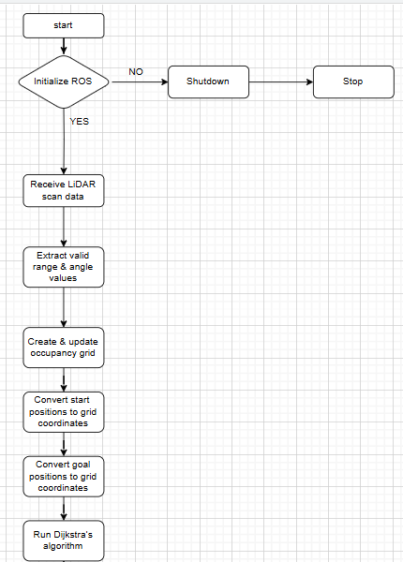
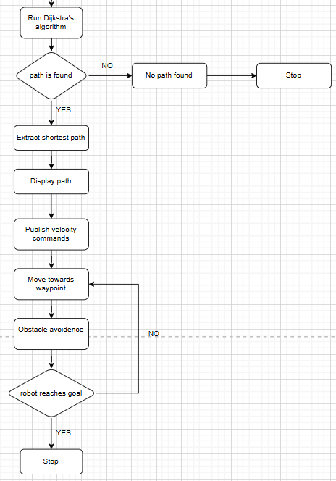
Flow-chart

Slide 6
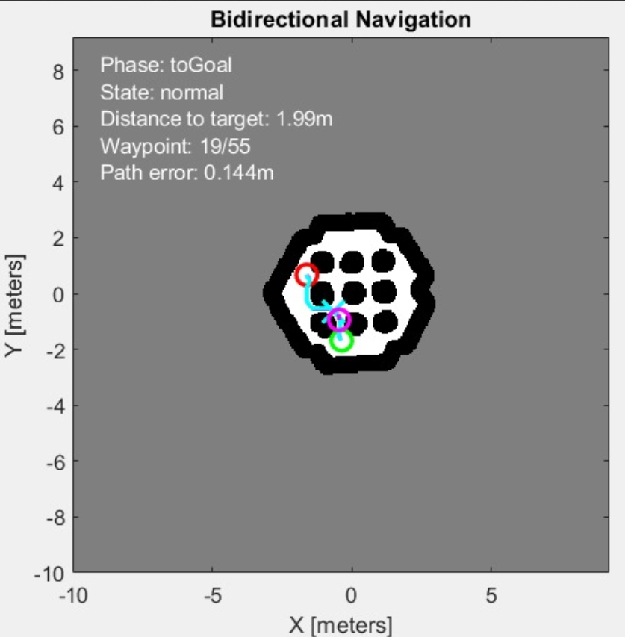
Simulation Result
Simulation Result
Robot path planning

Slide 7
REFERENCES
MATLAB:-
https://in.mathworks.com/help/robotics/ug/simulate-a-mobile-robot-using-gazebo.html
Gazebo:-
https://classic.gazebosim.org/tutorials
Set Up Gazebo Simulation Environment:-
https://in.mathworks.com/help/rtw/vexv5/ug/setup-gazebo.html

Slide 8
Conclusion
Developed an autonomous warehouse robot for efficient inventory management and navigation.
Integrated real-time simulation for obstacle avoidance and optimal path planning.
MATLAB controls the robot, and Gazebo creates a realistic 3D test environment
Future implements
Multi-Robot Coordination – Use multiple robots to manage the warehouse efficiently.

Slide 9
Thank You

